Slide 1
Clustering Metric, Weighted Graph Algorithm and Singular Spectrum Method for the Analysis of Scientific Data A Dissertation Proposal by: Yuping Lu (Allan)

Slide 2
The Candidate
Education
B.S. CS from Nanjing Agricultural University, China [2007 - 2011]
Admitted into PhD program at UTK, 2013
Advisor: Dr. Michael Langston
GRA at ARM Data Center, ORNL since October 2017
Mentor: Dr. Jitendra Kumar

Slide 3
The Candidate
Work Experience
Implementation Engineer at ZTE, China [2011 - 2012]
Office of Information Technology, UTK [2014 - 2017]
Manager: John Rose
UTK apache server configuration and optimization; SEO
Intern at the Scientific Data Group, ORNL [Summer 2017, Summer 2016]
Mentor: George Ostrouchov
R packages for HPC

Slide 4
A general introduction

Slide 5
Graph Basics
Graph: G = (V, E), a set of vertices (V) and edges (E).
Clique: C, is a subset of the vertices C ⊆ V, in an undirected graph G = (V, E), such that every two distinct vertices are connected with each other.
Notes:
Mention maximum clique, maximal clique. The clique decision problem is NP-complete. Finding a maximum clique is also NP-hard.

Slide 6
Graph Basics
Paraclique: a subgraph of G which is constructed from a maximum clique by adding vertices which are "highly connected”. The definition of "highly connected" is controlled by the glom factor g.
Notes:
Real data has missing edges, they’re not perfect cliques. Moreover, we frequently encounter enormous numbers of overlapping cliques. NP-complete? An example paraclique grown with glom term g = 2 from an initial maximum clique of size four {1,2,3,4} (a) and successively adding vertices 5 (b), 6 (c) and 7 (d).

Slide 7
Graph Basics
Biclique: or a complete bipartite graph, is a special kind of bipartite graph where every vertex of the first set is connected to every vertex of the second set.

Slide 8
Part 1: A robustness metric for clustering algorithms

Slide 9
Background
Cluster analysis is a core task in modern data-centric computation. But clustering algorithms often have one or more settings that can affect the clusters produced. Such a setting may represent, for example, a preset variable, a parameter of interest, or various sorts of initial assignments.
A question of interest then is this: to what degree do the clusters produced vary as setting values change?
Notes:
Add more info here.

Slide 10
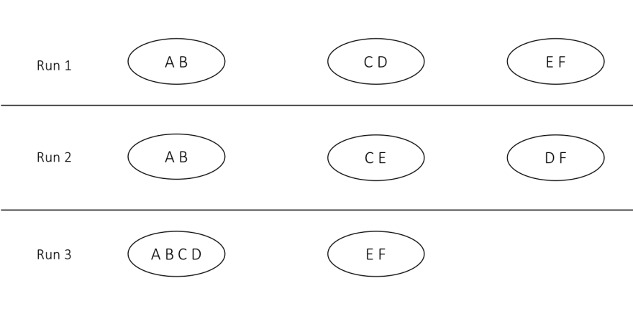
Robustness Metric
R = t / (dr)
t denotes the total number of (not necessarily distinct) pairs of objects that appear together in some cluster summed over all runs, d represents the number of distinct pairs of objects that appear together in some cluster produced by some run, and r is the number of times the clustering algorithm was run. Robustness thus lies in the interval (0, 1].
(A,B): 3/3; (A,C): 1/3; (A,D): 1/3; (B,C): 1/3; (B,D): 1/3; (C,D): 2/3; (C,E): 1/3; (D,F): 1/3; and (E,F): 2/3.
We now simply average these scores to compute R, making the robustness of the algorithm that produced these clusters 0.481.

Slide 11
Table 1. Clustering methods tested for robustness.
Algorithm | Type | Setting | Implementation
Average | Hierarchical | Number of clusters | R 3.2.3
Complete | Hierarchical | Number of clusters | R 3.2.3
Mcquitty | Hierarchical | Number of clusters | R 3.2.3
Ward | Hierarchical | Number of clusters | R 3.2.3
CLICK | Graph-based | Cluster homogeneity | Expander4
NNN | Graph-based | Min neighborhood size | Java
Paraclique | Graph-based | Starting clique | C++
WGCNA | Graph-based | Power | R 3.2.3
K-means | Partitioning | Number of clusters | R 3.2.3
QT Clust | Partitioning | Max cluster diameter | R 3.2.3
SOM | Neural network | Grid type/size | R 3.2.3
Notes:
Hierarchical clustering assigns items to clusters using a measure of similarity between clusters. Assignments are irrevocable; once an item has been placed in a cluster, it will remain in that cluster.
CLICK uses a graph-based statistical method to identify kernels and then expands them into full clusters with several heuristic approaches
NNN(Nearest Neighbor Networks), like paraclique, depends upon finding cliques and merge to form a single cluster
WGCNA operates on weighted networks using a soft threshold, raising the similarity matrix to a user-selected power in order to calculate extended adjacencies . It then identifies gene modules using average linkage hierarchical clustering and dynamic tree cut methods.
K-means clustering randomly selects k centroids and assigns genes to the nearest centroid, iteratively reassigning and recalculating centroids until it converges.
QT Clust builds a cluster for each gene, outputs the largest cluster, then removes these genes and repeats the process until no genes remain.
Self-Organizing Maps (SOM) is a machine learning approach that groups genes using unsupervised neural networks. SOM repeatedly assigns genes to the most similar node until the algorithm converges

Slide 12
Notes:
All 24 gene expression datasets are downloaded from GEO
Mention the spectral method here. This is the way we pick the threshold for paraclique.
Mention we combine all the 4 HC methods into one here.

Slide 14
14th International Symposium on Bioinformatics Research and Applications (ISBRA 2018)
A Robustness Metric for Biological Data Clustering Algorithms
Accepted

Slide 15
Part 2: A clique finding algorithm for weighted biological networks

Slide 16
Background
The gene co-expression network is a simple undirected graph G = (V, E), where genes as the set of vertices V, and the significantly co-expressed correlations between pairs of genes as edges E. The edge weight is in [-1, 1].
However, the edge weight is usually transformed into binary information.
Should we consider the edge weight of gene co-expression networks when computing cliques?
Notes:
Biological networks focus on the interactions between molecular level nodes which include DNA, RNA, proteins and metabolites. Different types of biological networks show different characteristics due to the type of its input data. protein-protein interaction networks and gene co-expression networks are different.
Among all the biological networks, gene co-expression network is in high demand to understand gene functions and mechanisms. And proteins are produced by coordinated co-expression of genes through transcription and translation, the study of co-expression patterns builds the base knowledge for underlying cellular processes. Thus, we tested our algorithms on gene co-expression networks.

Slide 17
Method
GO enrichment analysis interprets gene expression data and extracts groups of genes that share common similarities.
We use GO enrichment p-values from DAVID to evaluate the weighted paraclique algorithm.
The smaller the p-value is, the more significant the group of genes assigned to a specific GO term is.
Notes:
The gene ontology is a major bioinformatics initiative that provides the most comprehensive representation of gene and gene products. A typical usage of GO annotations is the gene ontology enrichment analysis.
What is DAVID? The Database for Annotation, Visualization and Integrated Discovery (DAVID )

Slide 18
The weighted paraclique algorithm

Slide 19
Table 2. Overview of all datasets in this study.
Notes:
Ecoli, fruit fly and yeast

Slide 22
The 9th ACM Conference on Bioinformatics, Computational Biology, and Health Informatics (ACM-BCB 2018)
Paraclique: A Clique Finding Algorithm for Weighted Graph
To be submitted

Slide 23
Part 3: Outlier detection on Atmospheric Radiation Measurement (ARM) data
Notes:
Mention this is the work with Jitu at ORNL.

Slide 24
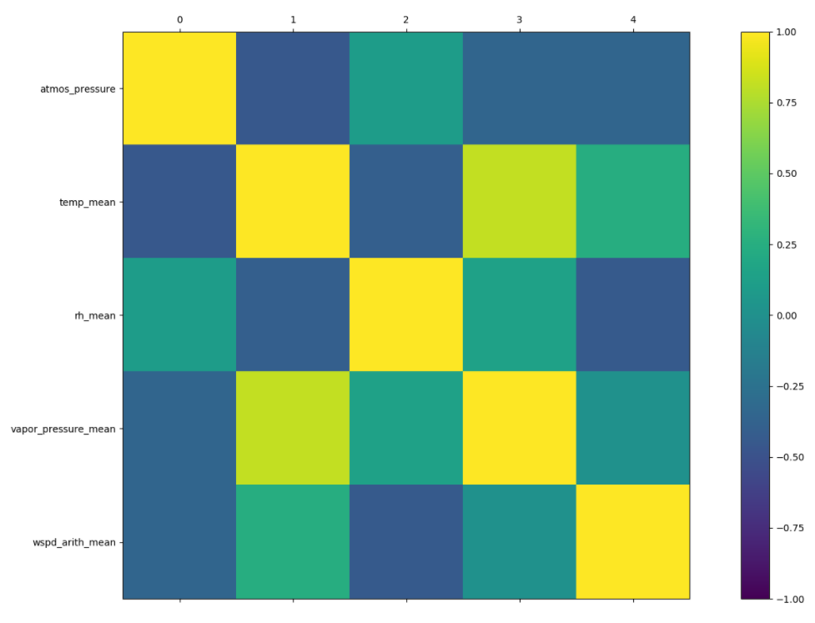
Outlier Detection on SGPMET Data
First, we want to see how well each pair of variables are related. Pearson Correlation are used to measure it.
Five variables are selected.

Slide 25
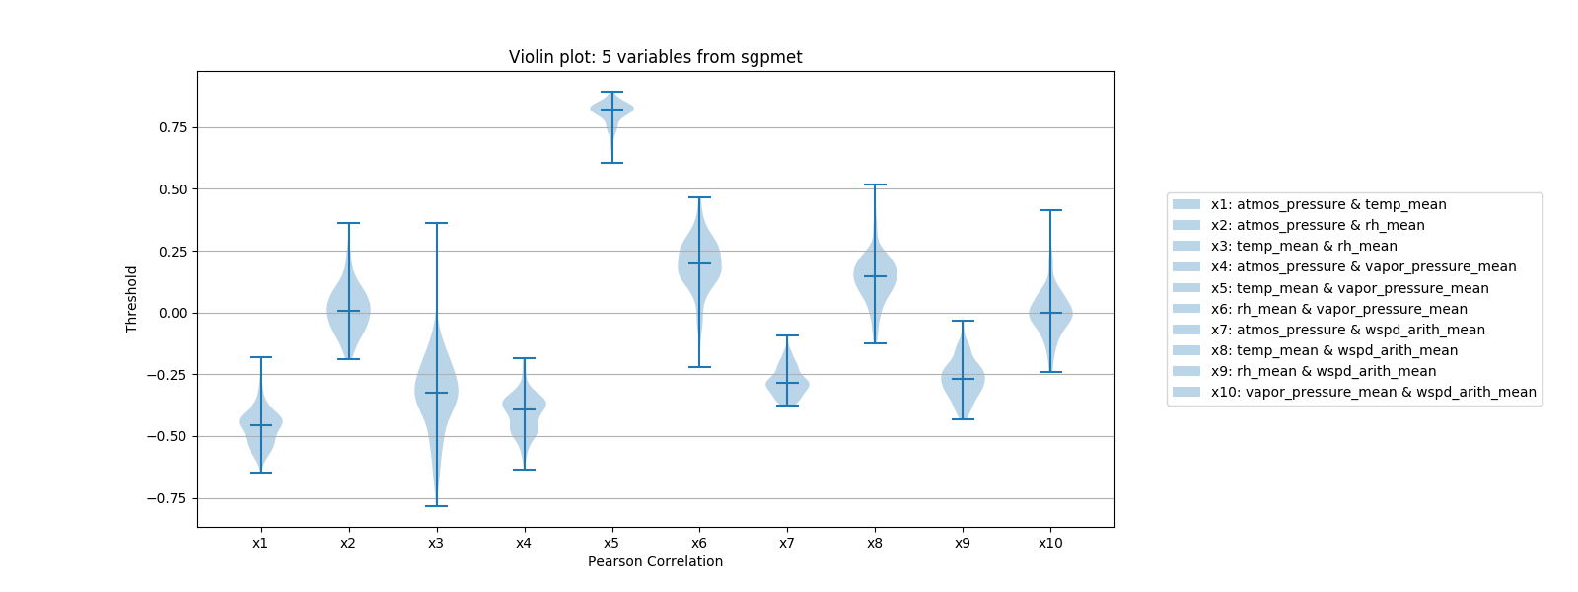
Correlations Between Variables

Slide 26
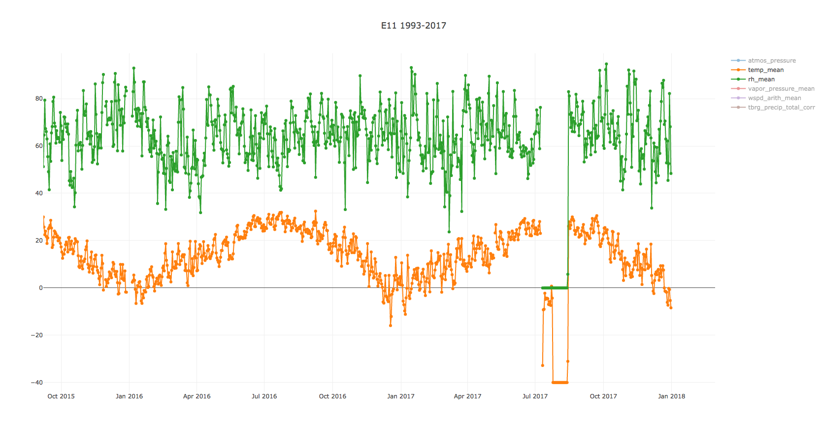
Drawback of Pearson Correlation
Notes:
Two variables both increase or drop and the change is extreme, but their Pearson Correlation may look normal.

Slide 27
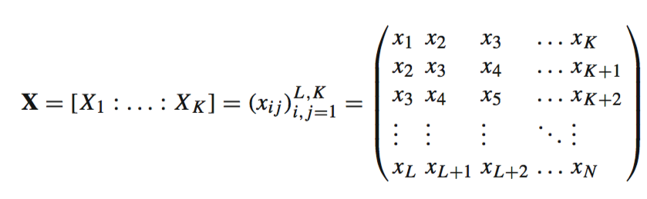
Singular Spectrum Analysis (SSA)
1st step: Embedding
A time series data T = (x₁ ,..., x_{N}) of length N. Let L (1 < L <= N/2 ) be some integer called the window length and K = N − L + 1.
X_{i} =(x_{i} ,..., x_{i+L−1})^{T} (1 ≤ i ≤ K)
Notes:
Form the trajectory matrix

Slide 28
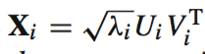
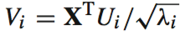
Singular Spectrum Analysis (SSA)
2nd step: Singular value decomposition (SVD)
Set S = XX^{T} and denote by λ₁,...,λ_{L} the eigenvalues of S taken in the decreasing order of magnitude (λ₁ ≥ ... ≥ λ_{L} ≥ 0) and by U₁,...,U_{L} the orthonormal system of the eigenvectors of the matrix S corresponding to these eigenvalues.
In this notation, the SVD of the trajectory matrix X can be written as
X = X₁ + . . . + X_{d}
where , , , and d = rank X.
Notes:
Perform the singular value decomposition (SVD) of the trajectory matrix X.

Slide 29
Singular Spectrum Analysis (SSA)
3rd step: Find the dominant frequency of each eigenvector
4th step: Build an approximation of X by taking a subset of the decomposition. This approximation is formed by taking eigenvectors whose dominant frequency is close to the targeted values.
5th step: Now we reconstruct the signal by taking a mean of the approximations.
Notes:
Perform the singular value decomposition (SVD) of the trajectory matrix X.

Slide 30
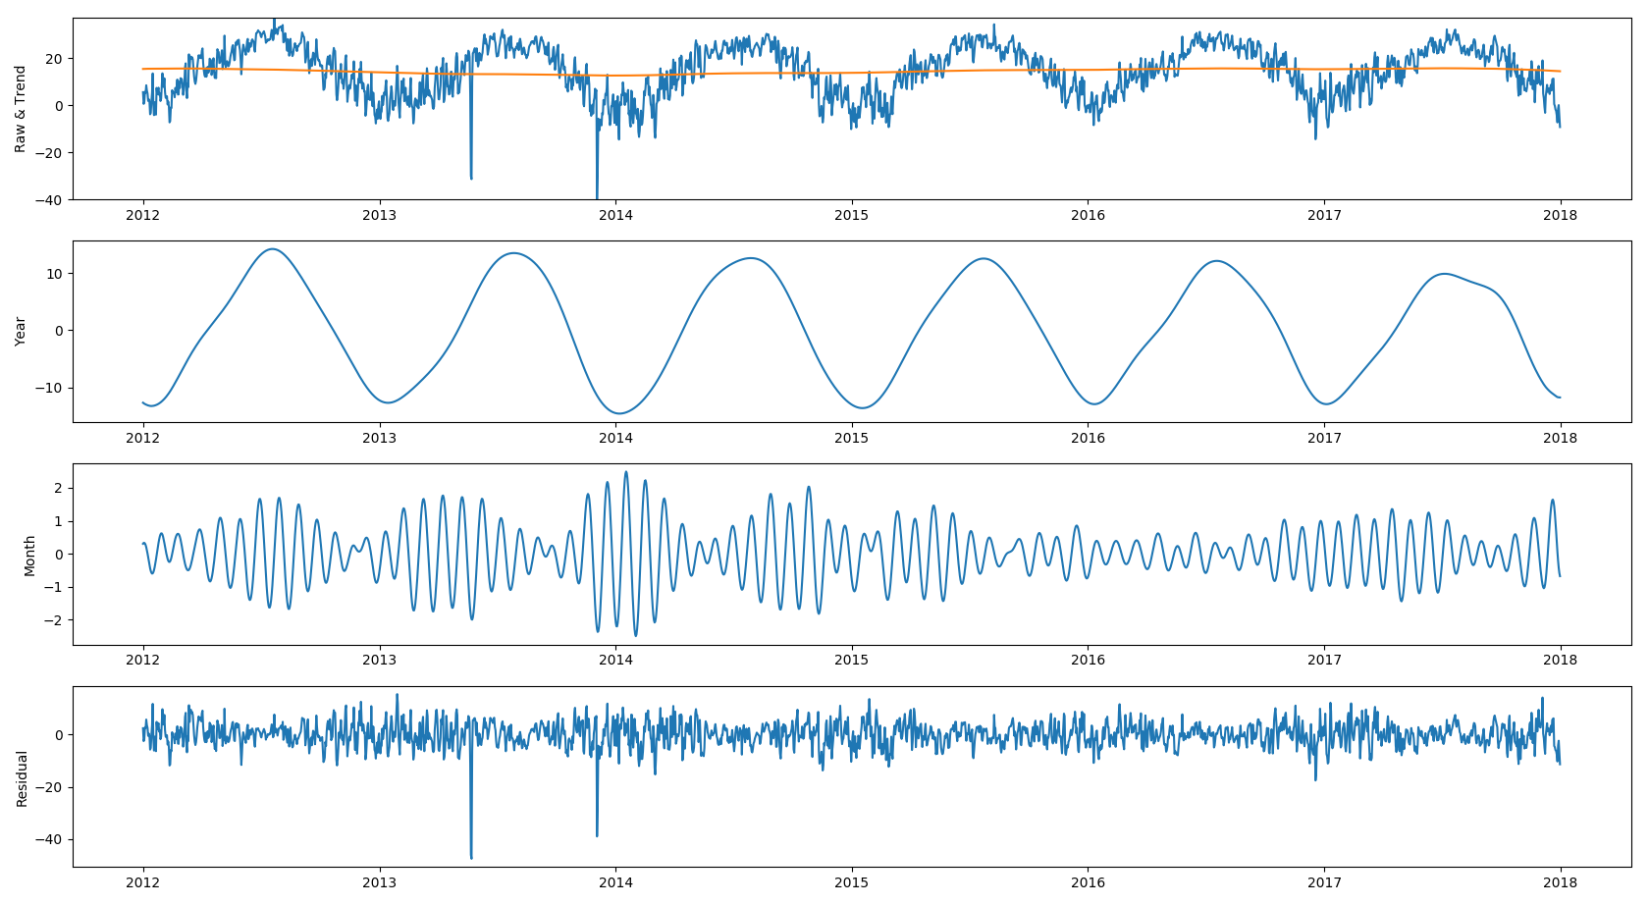
Singular Spectrum Analysis (SSA)
E33 2012-2017 temp-mean

Slide 31
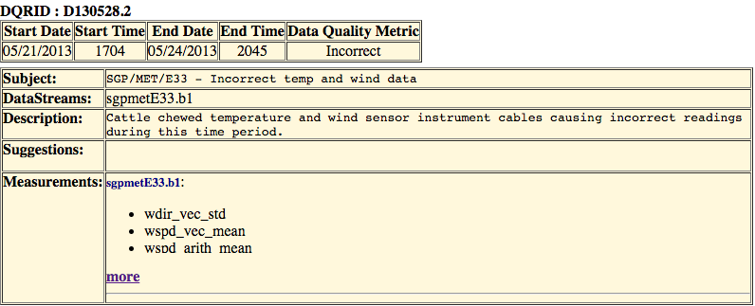
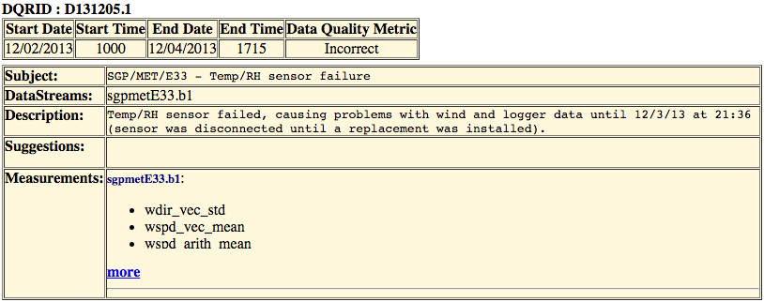
Singular Spectrum Analysis (SSA)
Outlier 1
May 2013
Outlier 2
Dec 2013
https://github.com/YupingLu/arm-pearson
https://github.com/YupingLu/arm-ssa

Slide 32
IEEE International Conference on Data Mining (ICDM 2018)
Plan to submit the paper to this conference.

Slide 33
Part 4: Maximal Biclique enumeration R package

Slide 34
Biclique Implementation
Maximal biclique enumeration is the task of listing (typically the sets of vertices comprising) all maximal bicliques in a graph. A bipartite graph with n vertices may contain as many as 2^{n/2} maximal bicliques.
Implemented Yun Zhang’s algorithm [1] in R.
[1] Zhang Y, Phillips CA, Rogers GL, Baker EJ, Chesler EJ, Langston MA: On finding bicliques in bipartite graphs: a novel algorithm and its application to the integration of diverse biological data types. BMC Bioinformatics 2014, 15(1):110.
Notes:
A maximum biclique is a biclique of largest size in a bipartite graph, with size being measured either by the number of vertices (vertex-maximum) or the number of edges (edge-maximum). Finding an edge-maximum biclique can be accomplished in polynomial time. Finding a vertex-maximum biclique is NP-hard. A maximal biclique is a complete bipartite subgraph to which no vertex can be added to form a larger biclique.

Slide 35
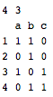
bicliques = bi.clique(filename, lleast, rleast, version, filetype)
5 4 10
L1 L6
L1 L7
L2 L8
L2 L9
L3 L8
L4 L7
L4 L6
L4 L9
L5 L6
L5 L8
Edge list format.
Binary matrix format.
Notes:
It’s easier for domain scientists to use and also fast to compute the bicliques as the backend is implemented in C. These are our own defined formats with number of vertices and number of edges added to the header.

Slide 36
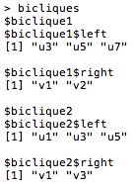
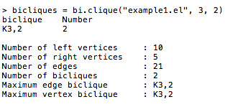
A call to bi.clique specifying the minimum sizes of bicliques to report. And listing the bicliques saved in the bicliques variable.

Slide 37

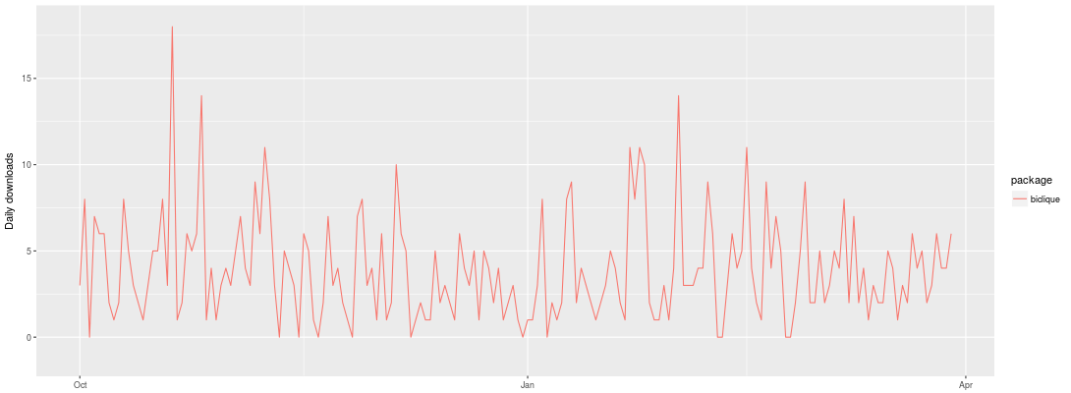
Biclique Download Stats

Slide 38
BMC Research Notes
Biclique: Maximal Biclique Enumeration in Bipartite Graphs
To be submitted

Slide 39
Milestones
Spring 2018 – Finish the weighted paraclique paper and biclique paper.
Summer 2018 – Finish outlier detection paper.
Fall 2018 - Finalize research results for dissertation. Schedule dissertation defense.
November 2018 - Defend dissertation. Submit final copy of dissertation to graduate school.
Detailed progresses are available at http://yupinglu.me/dissertation

Slide 40
Thank you for your attention!
Any questions?

